Slide 1
The importance of culture in society

Slide 2
DEFINITION
In this work we want to highlight the importance of culture in society, but above all we will emphasize the importance of approaching culture and cultural heritage to the little ones in a playful way through different materials and didactic activities.

Slide 3
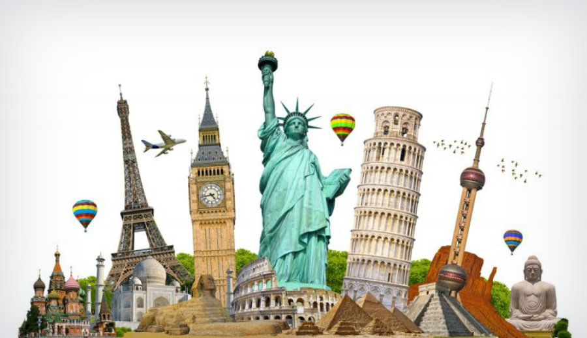
¿ What does culture mean?
There are a lot of definition about the culture and cultural heritage, but we have chosen the most correct definition in our opinion.
  Scazzosi (2004) and Heyd (2005) consider that heritage as a whole allows us to comprehensively know societies both past and present, generating structures of social identity that become cultural symbols.

Slide 4
IMPORTANCE OF THE INTERVENTION
At present we can see how knowledge about cultural heritage and the feeling of belonging is being lost, especially among young people. For this we consider it important to start working from an early age with the aim of preserving or inculcating the importance of cultural heritage in our society.

Slide 5
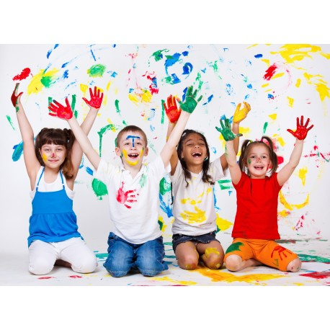
When working from such an early age the concept of heritage, it is possible to change and modify cultural behaviors or stereotypes, giving rise to the acquisition of values and significant learning for the student, generating a positive awareness on the part of the individual towards the environment and the heritage that It surrounds you.

Slide 6
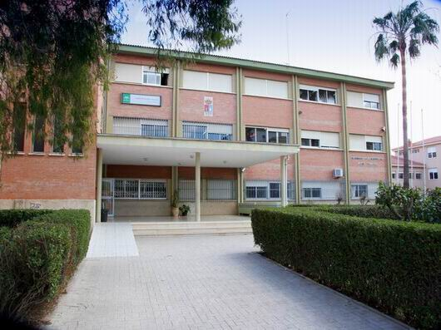
IES MARIA ZAMBRANO (GRANADA)
Localitation: North area of Granada
8-10 years students
Reason: Problematic area

Slide 7
OBJECTIVES
GENERAL OBJECTIVES
  Make easier the understanding of past and present societies through the study and analysis of heritage assets linked to our cultural roots and traditions.
SPECIFIC OBJECTIVES
  Interactive and multidirectional projects with activities that allow the interpretation of heritage.
  Make easier the critical and reflective knowledge of the culture.
  Direct contact of the students with the patrimonial elements or virtual simulations of them.

Slide 8

ACTIVITIES

Slide 9
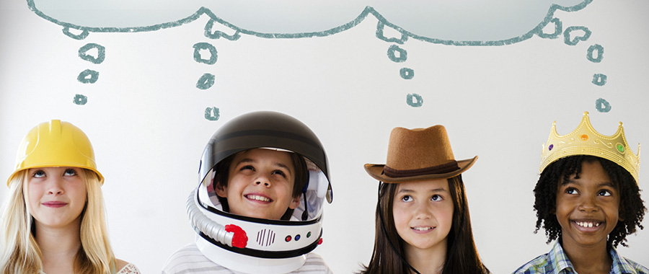
ACTIVITY 1: PUBLIC MONUMETS
Duration: 1:20 hrs.
Materials: papers, boxes, comfort tubes, yoghur containers, among others.
Objectives: Theater a public monument invented by girls and boys.

Slide 10
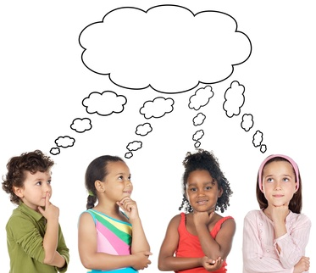
ACTIVITY 2: I PUT ON MY MONUMENT CAP TO LOOK
Duration: 1:30 hrs.
Materials: Papers, scissors, glue, cloth, colored pencils, recycled materials
Objectives:
  1. Identify elements of heritage present in the territory.
  2. Recognize our built environment and some of its patrimonial icons.

Slide 11
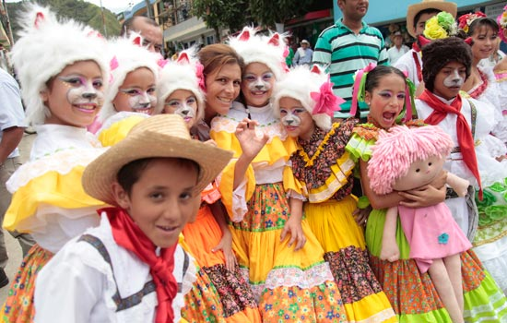
ACTIVITY 3: WE BUILD THE MISSING MONUMENT
Duration: 1.20 hrs.
Materials: Boxes, cardboard, wood, bottles, wool, cloth, rope and glue.
Objectives:
  1. Understand the different uses of public space.
  2. Link the built environment and the community in a playful and creative way.

Slide 12
ACTIVITY 4: MEET A MONUMENT WITH THE SENSES
Duration: 1:15 hrs.
Materials: Meet a monument with the senses
Objectives:
  1. Know a monument through the senses: hands, smell, sight and sound.
  2. Identify the elements that constitute a monument as a public work.
  3. Strengthen and awaken curiosity to investigate through the senses and their relationship with the environment.

Slide 13
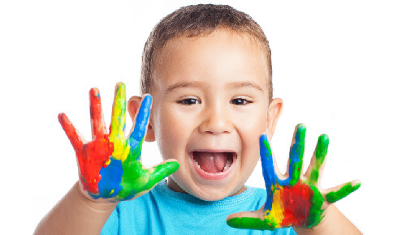
ACTIVITY 5: TO PAINT WITH YOUR HANDS!
Duration: 1:30 hrs.
Materials: Clay or colored earth, coffee, water, cold glue, bird feathers, sticks...
Objectives:
  1. Recognize the archaeological heritage through play and experimentation.
  2. Discover the rock art and techniques used in antiquity.
  3. Experiment with paintings and utensils made by the girls and boys themselves

Slide 14


