Slide 1
Spain AND TURKEY, culture to discover
Work of: Lourdes Cozar de la Casa, Muhammed Cagri Baskent and Alberto Cano

Slide 2
WORKS OF Antonio GAUDÍ IN BARCELONA

Slide 3
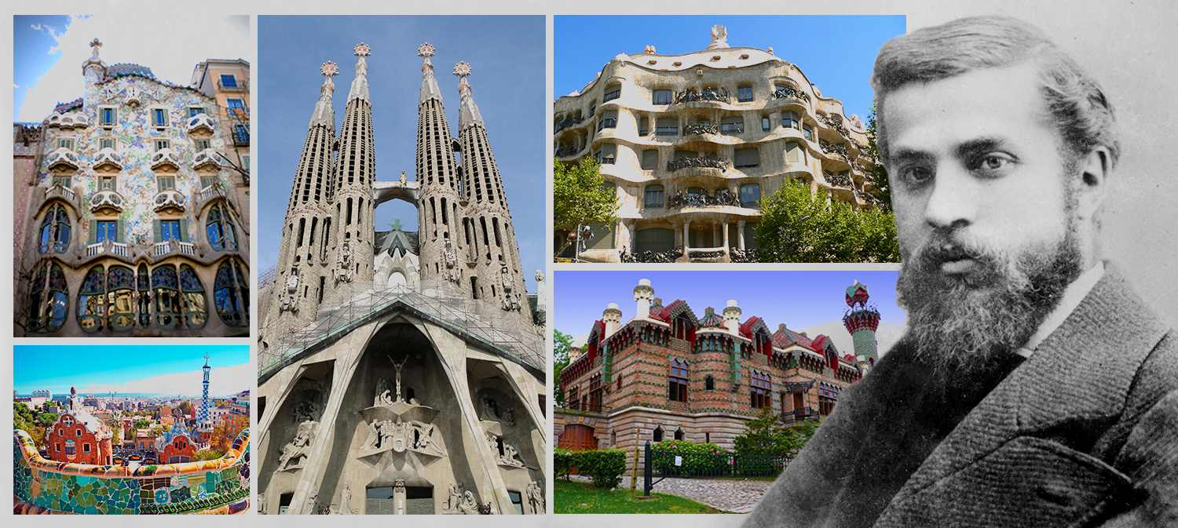
Antonio Gaudí (1852–1926)
-Reus
-Modernisme
-Spanish architect of the final of 19th century

Slide 4
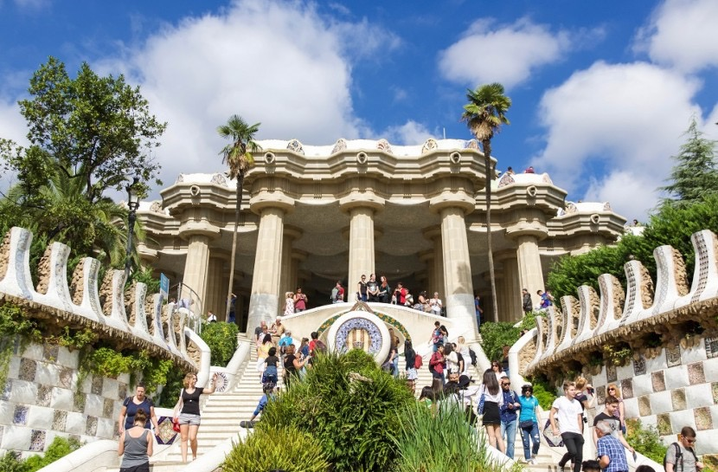
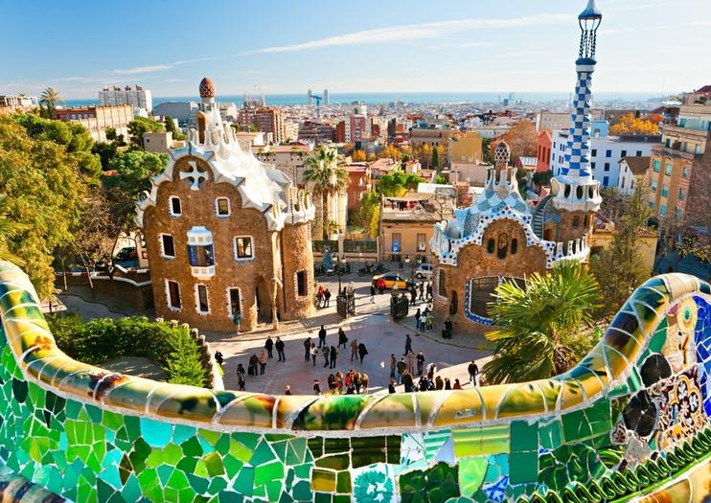
The Park Güell
-Gaudí’s artistic plenitude
-Naturalist phase
-Organic shapes
-Inspired by the Temple of Apollo of Delphie

Slide 5
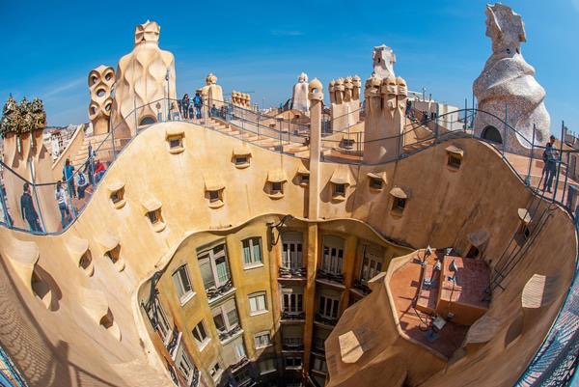
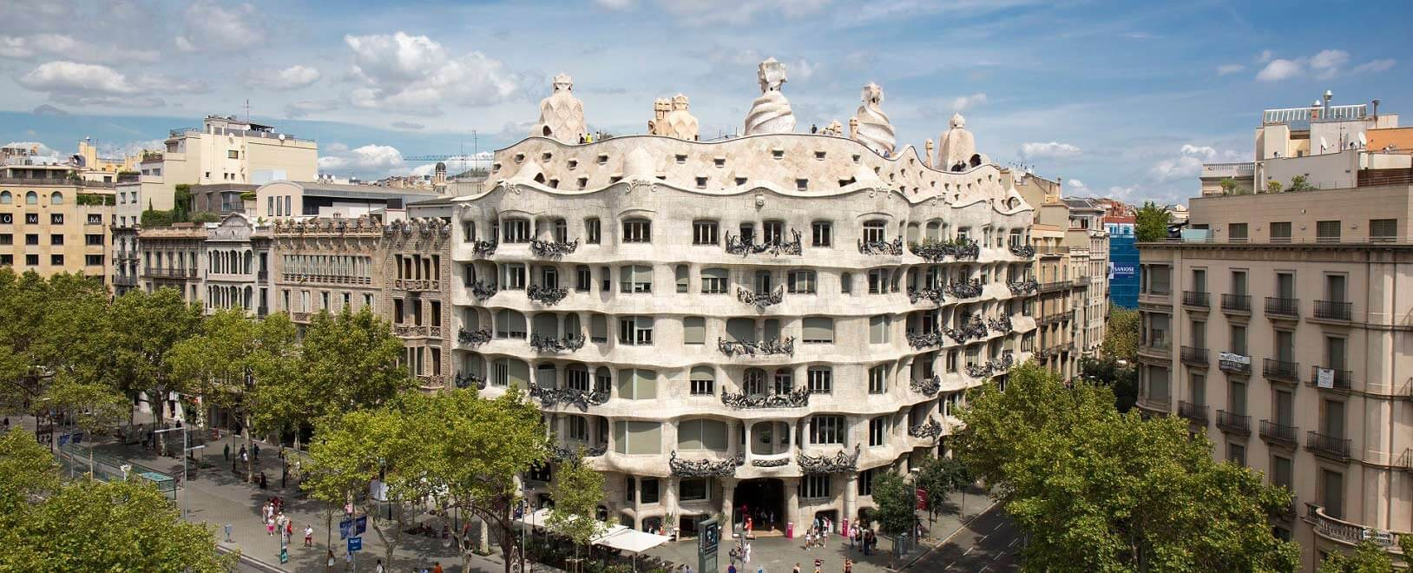
The Casa Milà-La Pedrera
-Built for Roser Segimón and her husbamd Pere Milá
-Administrative problems
-Curious roof and chimneys
-Last private residence designed by the architect (1906-1912)

Slide 6
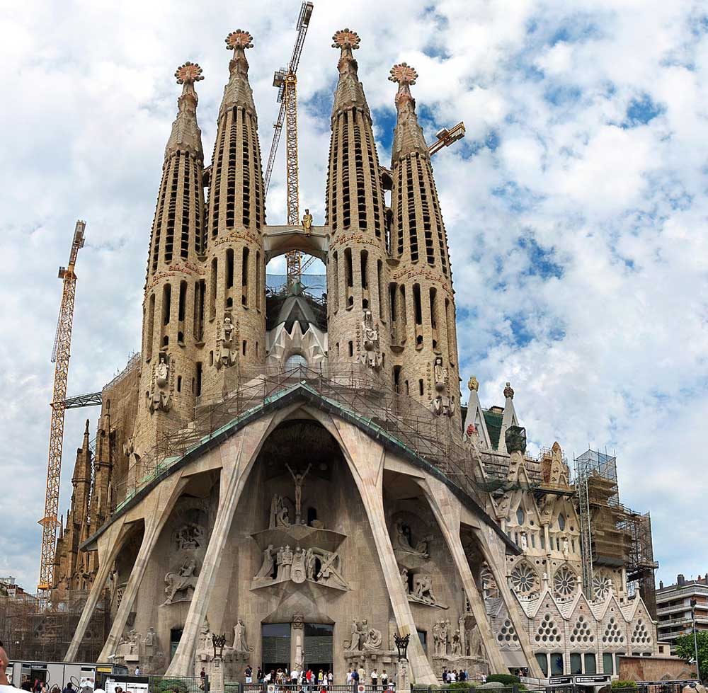
The Nativity Façade
-Most famous work
-Finished ¼ when he died
-Still unfinished
-Small fire in 2011

Slide 7
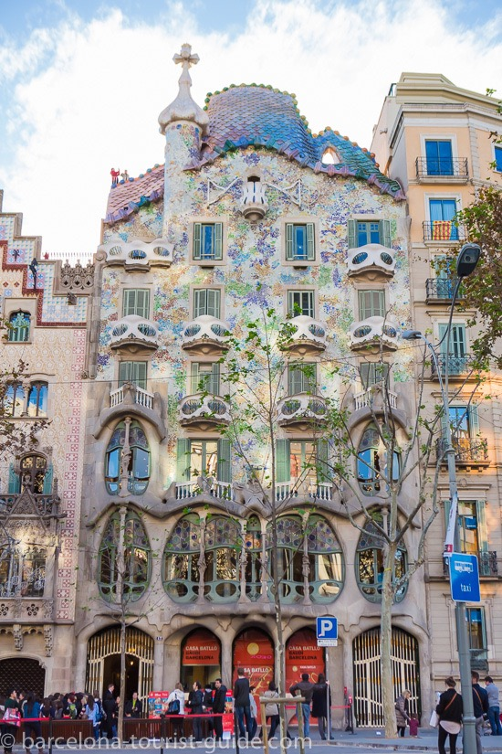
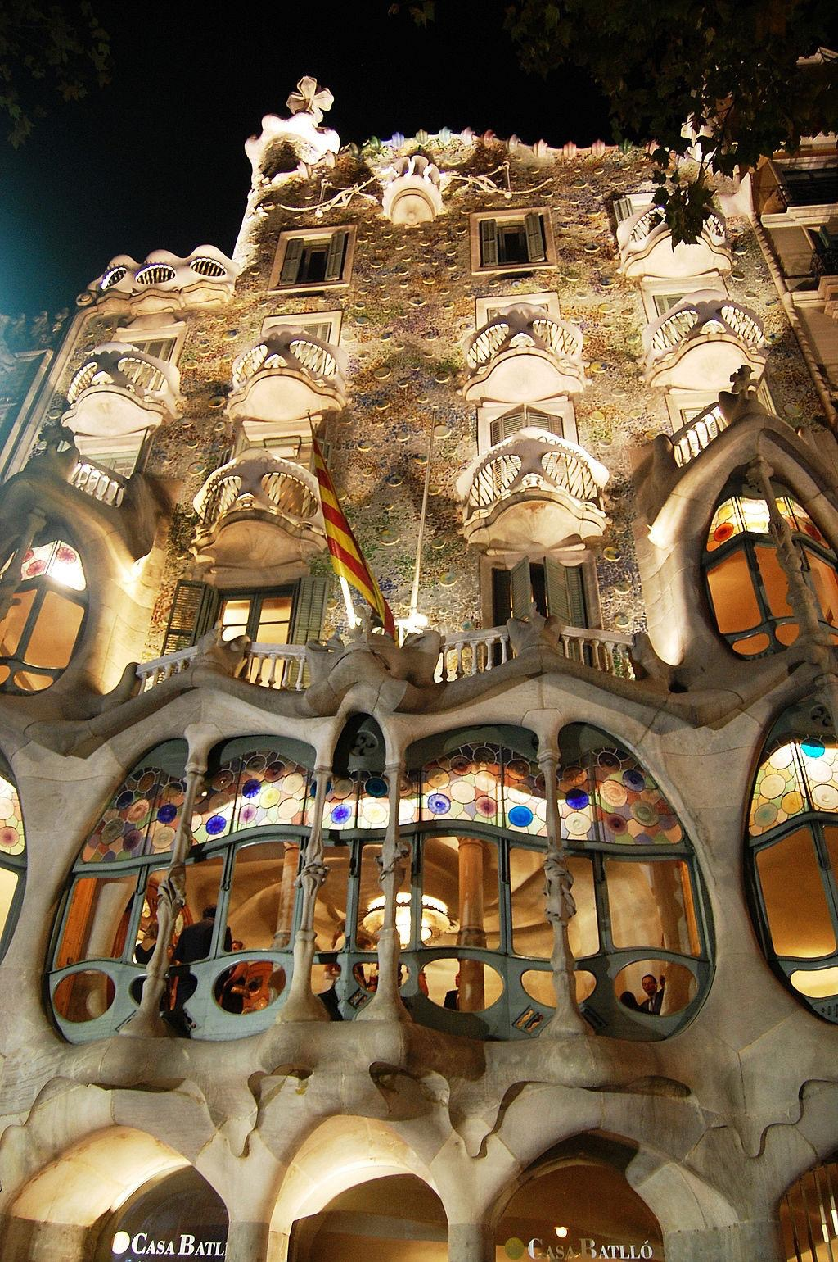
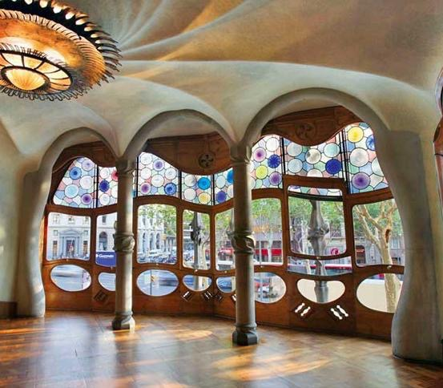
the Casa Batlló
-One of his masterpieces
-Redesigned in 1904
-Built in 1877

Slide 8
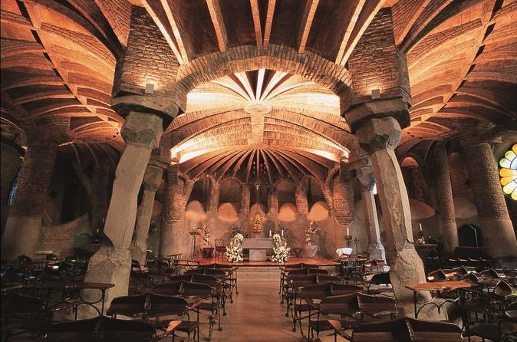
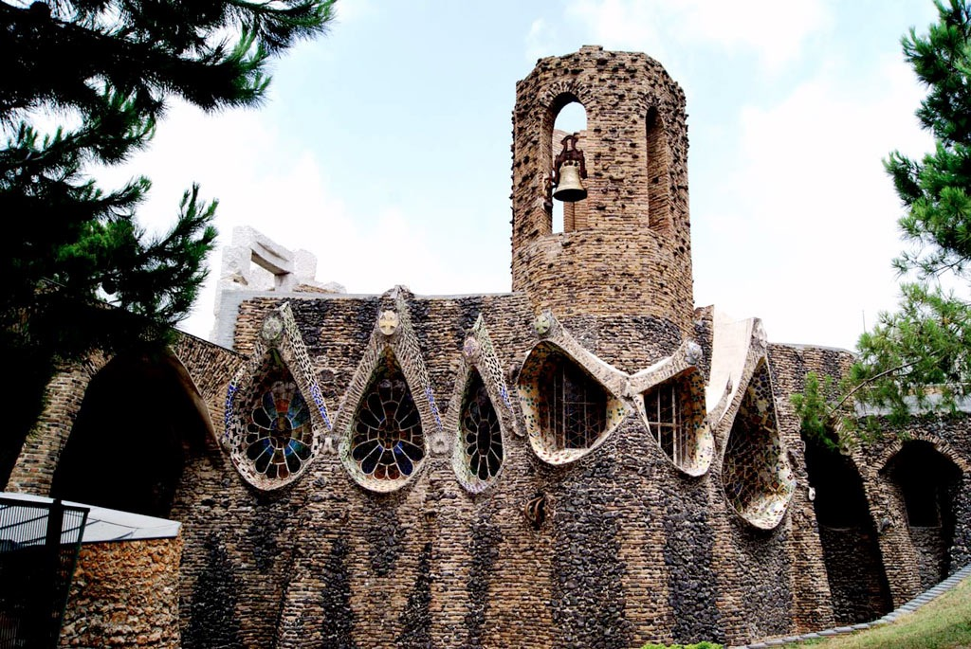
Crypt of the Colònia Güell
-Personal style
-Place of worship in Samya Coloma of Cervelló
-Only the crypt was completed
-Reparation of the Crypt in 2000

Slide 9
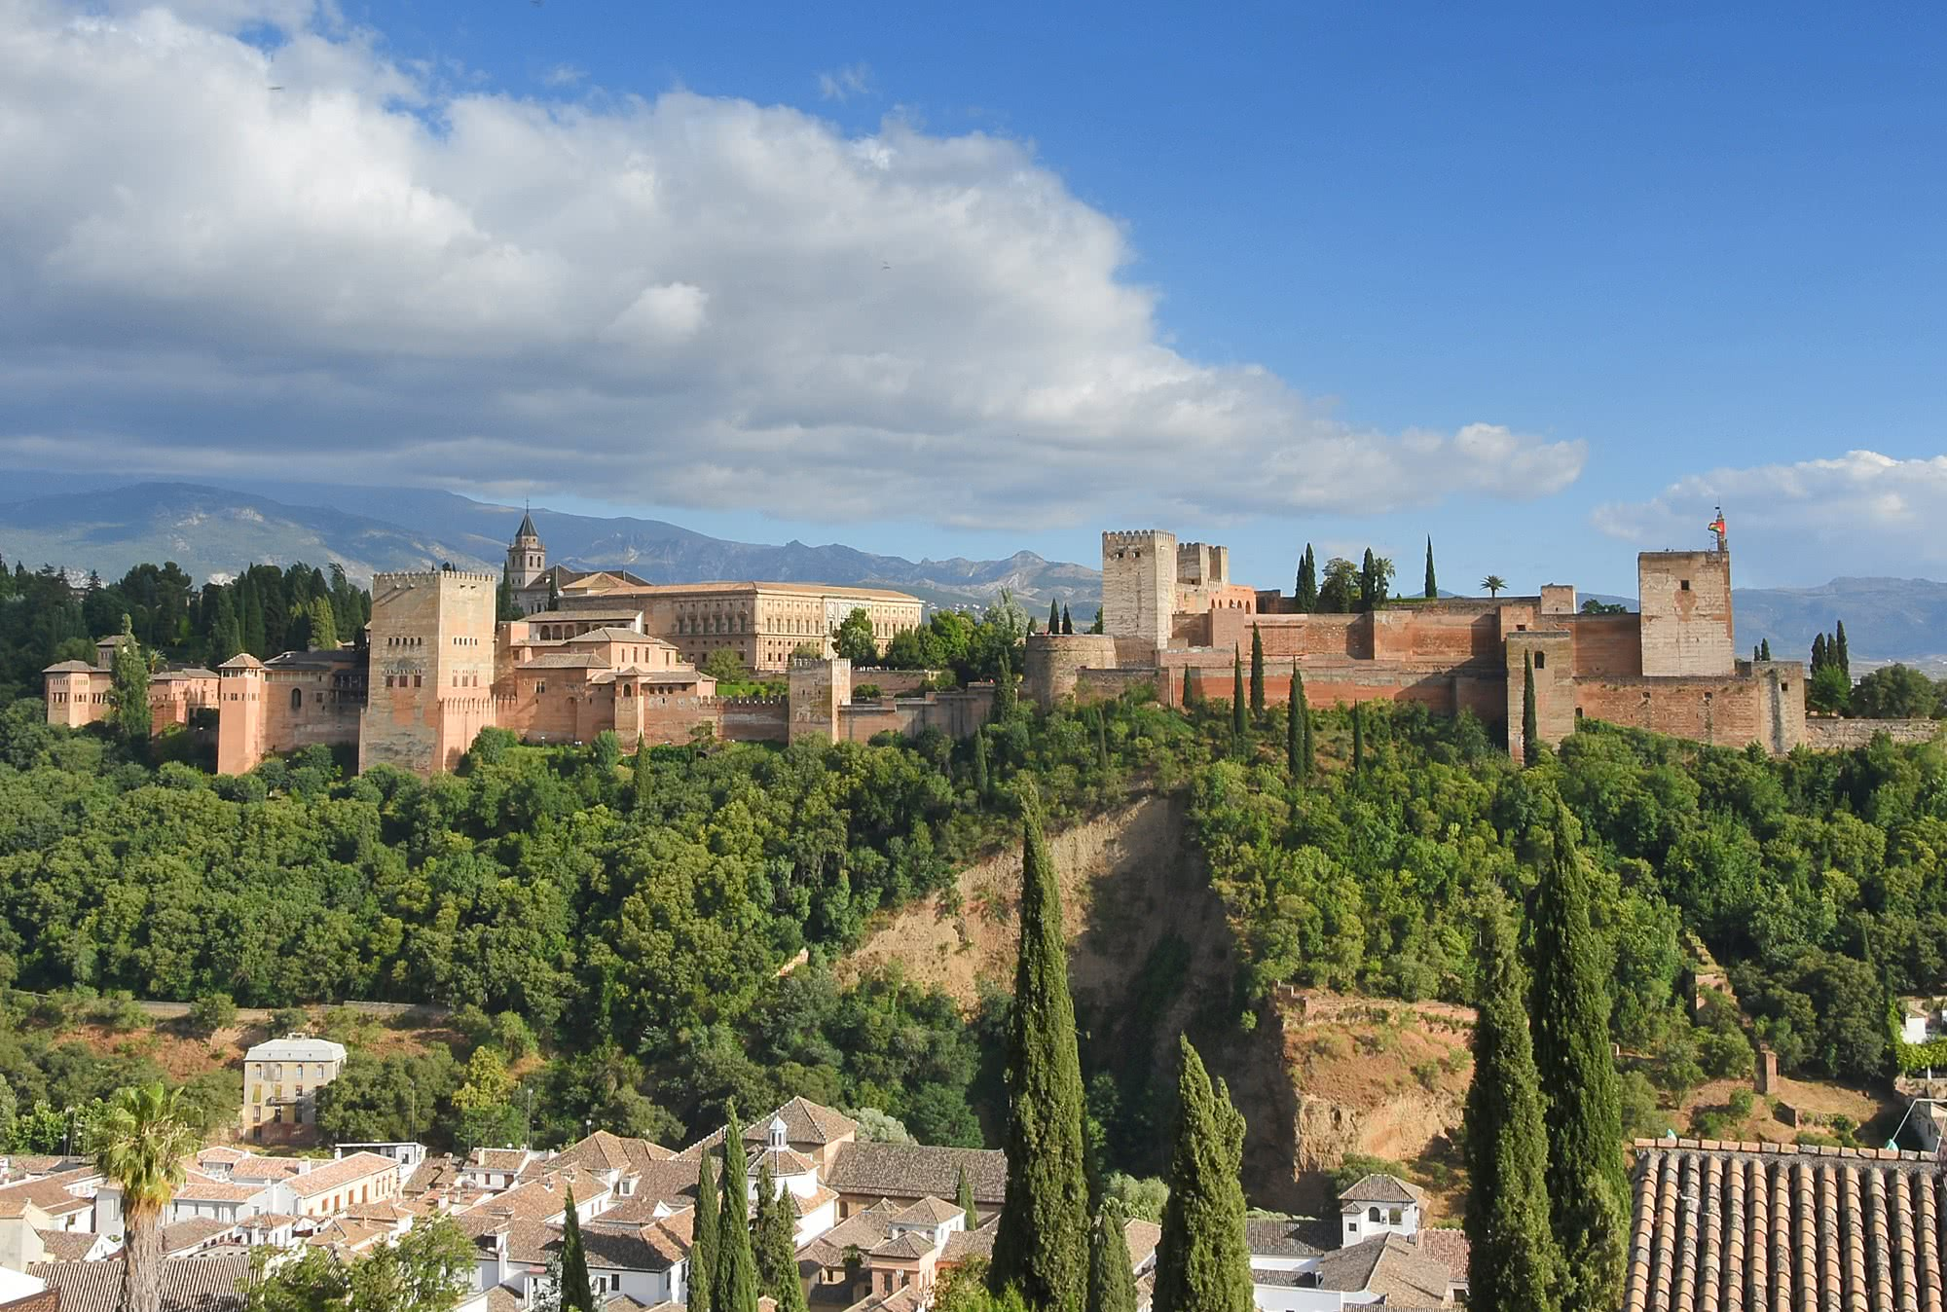
Alhambra, Generalife and Albayzin
Granada, Spain

Slide 10
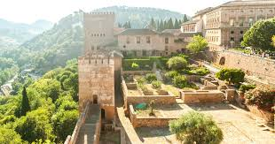
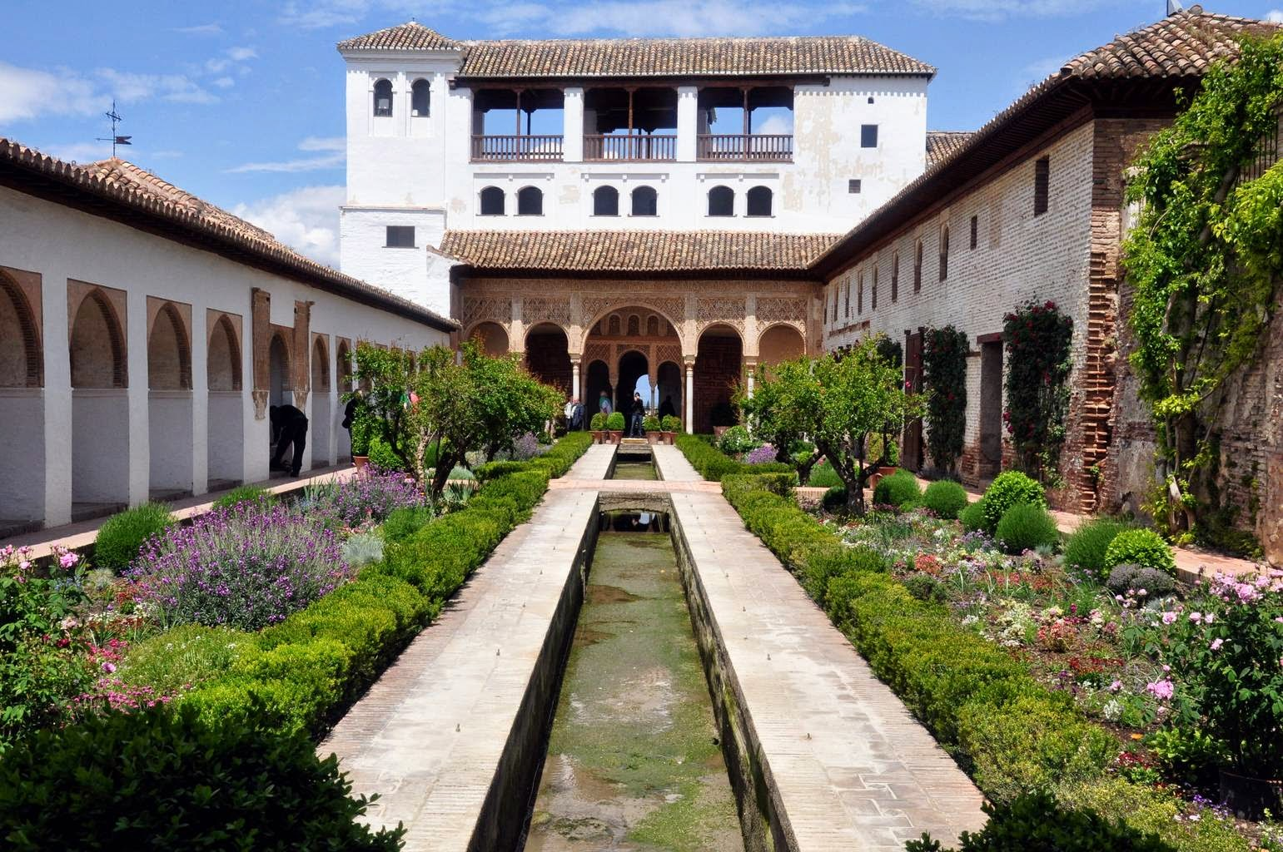
Former rural residence of the emirs who ruled part of Spain (Al Andalus) in 13th-14th century
Rich repository of Moorish vernacular architecture
Unique preserved palatine city of the Islamic period

Slide 11
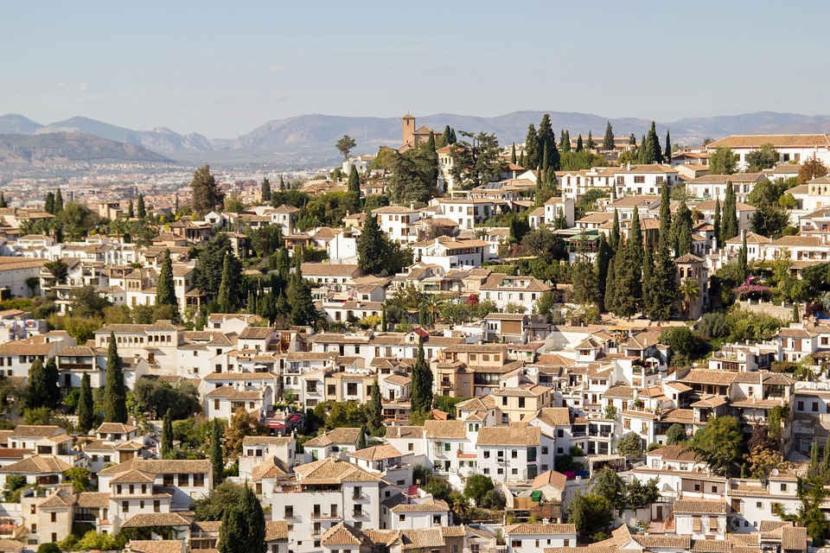
The Alhambra and Generalife contain all the known artistic techniques of the Hispano-Muslim world. They bear a testimony of Muslim Spain from 13th to 15th century,
The Albayzín district is the best preserved example of a Hispano-Muslim city. With the combination of techniques of the Nasrid Dynasty and of Christian Renaissance and Spanish Baroque Culture.

Slide 12
Architecture elements
Emphasis on the aesthetic value of buildings, with the use of water and vegetation as ornament.
Development of materials used in the Alhambra and Generalife with the use of plaster, wood and ceramics as decorative elements. The use of Arabic epigraphy gives the model of “talking architecture”.
Decorative program based upon geometry, epigraphy and vegetation, as the most typical Mocárabe vaults.
Respect of the original style, with minimal adding.

Slide 13
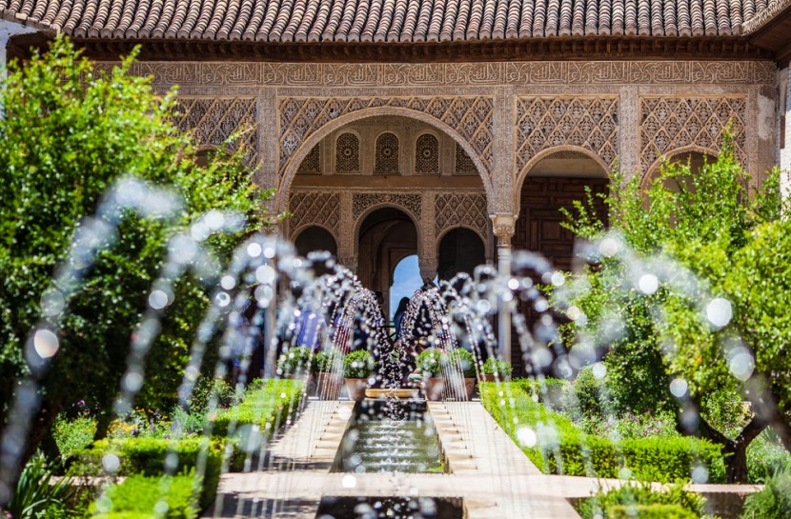
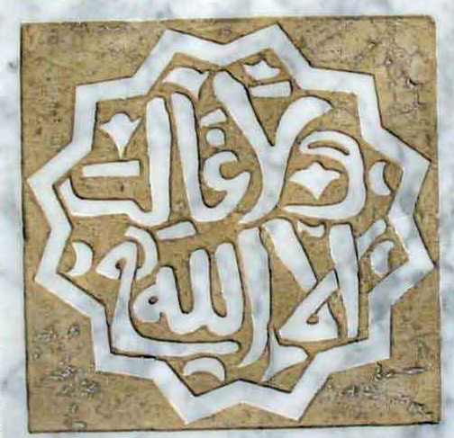
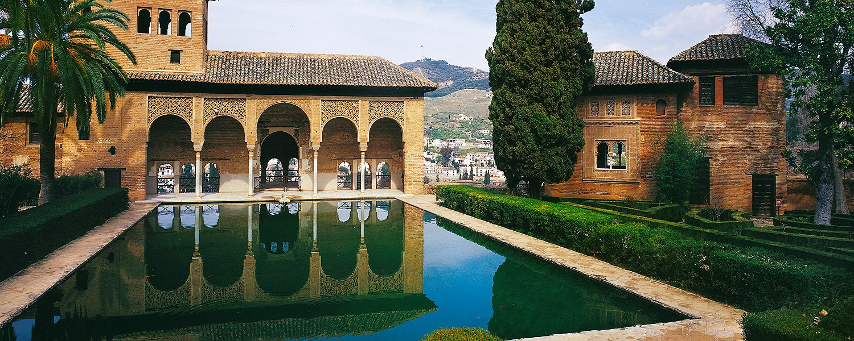
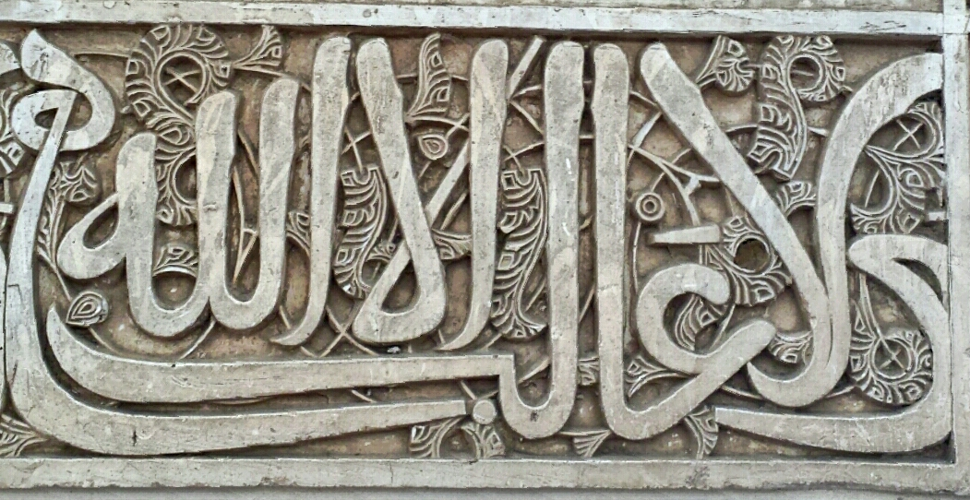

Slide 14
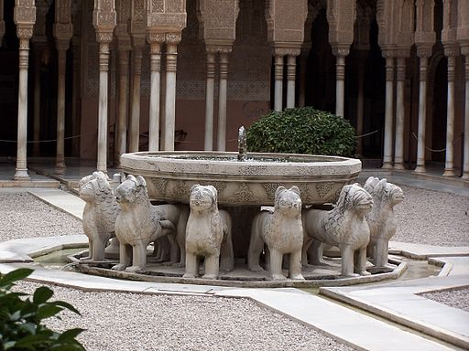
Lion’s Fountain
One of the few animal sculptures in the Islamic art, because rejected in the Koran
Different symbolism, zodiacal (12 of them), meaning of King Salomon (inscription in the fountain). Understood as allegory of Sultan’s power.

Slide 15
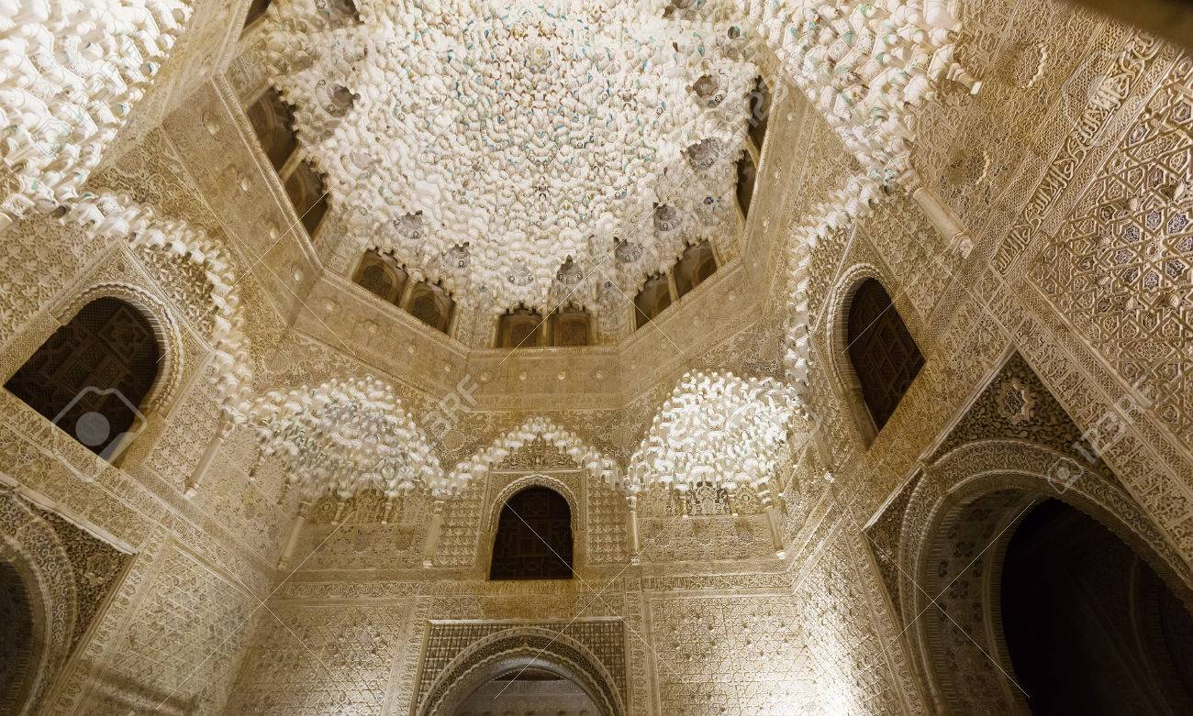
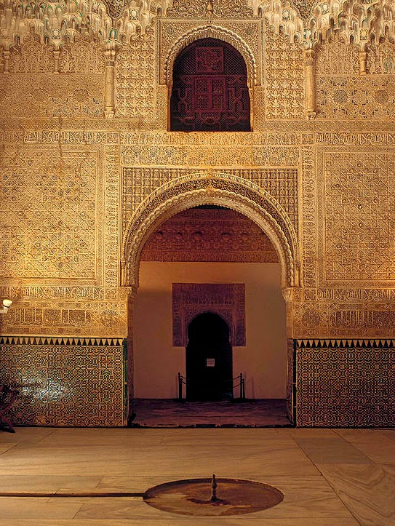
Two Sisters’ Room
Original door of inlay (preserved in museum).
The name comes from the two white marbles slabs on the ground on both sides of the central fountain. Equal in size, color and weight.
Viewpoint over the city and direct communication with bathrooms

Slide 16
ANİ RUİNS
TURKEY

Slide 17
Ani is a ruined medieval Armenian city now situated in Turkey's province of Kars, next to the closed border with Armenia
Between 961 and 1045, it was the capital of the Bagratid Armenian kingdom that covered much of present-day Armenia and eastern Turkey. Called the "City of 1001 Churches", Ani stood on various trade routes and its many religious buildings, palaces, and fortifications were amongst the most technically and artistically advanced structures in the world.

Slide 18
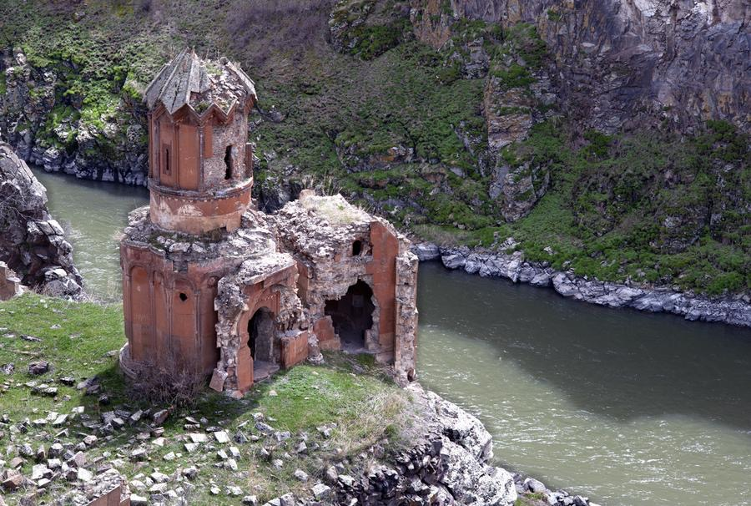
Ani was one of the biggest cities in the world, and its population was probably on the order of 100,000.

Slide 19
This medieval city that was once one of the cultural and commercial centers on the Silk Roads, is characterized by architecture that combines a variety of domestic, religious and military structures, creating a panorama of medieval urbanism built up over the centuries by successive

Slide 20
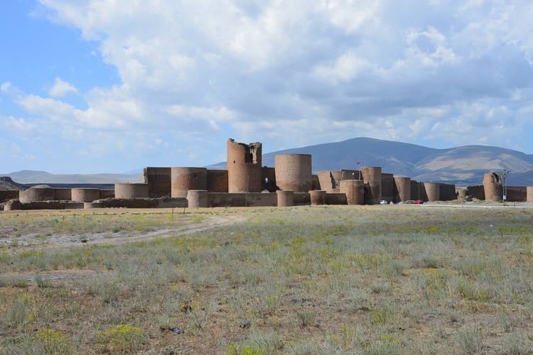

Slide 21
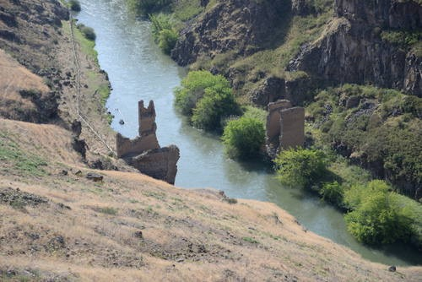
Archaeological evidence suggests that the site of Ani was inhabited from the Early Iron Age (1200-1100 BC).

Slide 22
The city flourished in the 10th and 11th centuries CE when it became the capital of the medieval Armenian kingdom of the Bagratides and profited from control of one branch of the Silk Road. Later, under Byzantine, Seljuk and Georgian sovereignty, it maintained its status as an important crossroads for merchant caravans.

Slide 23
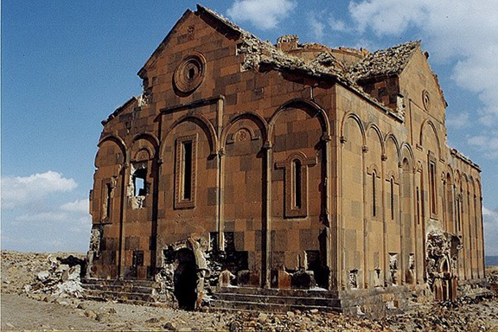

Slide 24
